Slide 1
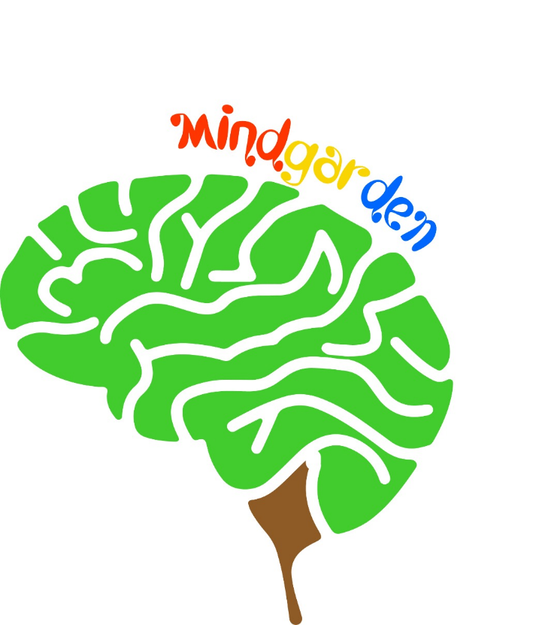
MInd Garden
A Serıous Game Platform for chıldren
Team Members:
Ali Kaan Göksu: 201511026
Emre Kasar: 201511038
Eyüp Taşkın: 201511059
Kazım Ataol Özüseven: 201411049
AdvIsor:murat saran

Slide 2
contents
AIM OF STUdy
Serıous games
Problems and solutıons
Sımılar projects
What ıs our difference?
Informatıons of the study
Project contrıbutıons
Technology used
Potentıal rısks
Success crıterıa
Project work plan
Game overvıew

Slide 3
AIm of Study
Create a digital platform containing serious games for children to enhance the capabilities of their motor skills.

Slide 4
Serıous games
A game designed for a primary purpose other than pure entertainment.

Slide 5
Problems and SolutIons
Problem
SolutIon
Education is boring for some children.
Kids can spend a lot of time playing games.
Playing not inspected games for children could lead to serious harm in children’s psychology.
Serious games increases interests for education.
Limiting the time of gameplay to avoid game addiction.
Designing games under the guidance of a pedagogue.

Slide 6


SImIlar Projects
MentalUp: Focuses on kindergarten children's mindset. It aims to help children develop their mental skills and discover their potential through fun brain exercises.
Toca Boca: The main goal for the company makes fun games for kids and keep children away from harmful games.

Slide 7
What is our Difference ?
Unlike other applications we have a time limit on our game to avoid game addiction.
It is not the player who determines the difficulty of the game, game has adaptive difficulty based on player’s performance.

Slide 8
InformatIons of the Study
Definition: Develop a digital game platform containing serious games.
Designed for children in ages 7 – 11.
Compatible in Android.
Main Features
Series of serious games.
Rewarding system.
Adaptive difficulty
Constraints
All game components should be child friendly.
Limited screen time.

Slide 9
Project ContrIbutIons
Enjoyable and efficient way to mind improvement.
2D child friendly environment. Environment contains a mascot to show and teach how to use UI of the application.
Change mascot by using rewarding system.
Storing data of the players for adaptive difficulty.

Slide 10





Technology Used
Unity Game Engine
Photoshop CC
Adobe Illustrator CC
Visual Studio Community
Android Studio

Slide 11
PotentIal RIsks
Occured Problem | Reason | Solution | Priority
Bugs and failures in game | Unexpected input | Debug and control random generated input | High
User interface is complicated and dull | Tutorial is not enough and environment is not interesting for kids. | Improve tutorial and redesign game environment. | Medium
Reward system is not satisfying | Rewards are not intresting | Gathering unique assets for rewards | Medium

Slide 12
Success CrIterIa
Success Criteria | How to Measure
Succesfull operating games | Usability Test
Attention of children is positive | Survey with users
Properly gathering and analyze the data | Observing users in a period of time
Understandable and usable user interface | Survey with users

Slide 13
Project Work Plan
Work | Done By
Game Design/Development | Ali,Emre,Kazım
Adaptive Difficulty | Eyüp
Data Storage | Eyüp,Emre
Tests | Ali,Kazım
Access Management | Emre
UI Design | Ali

Slide 14
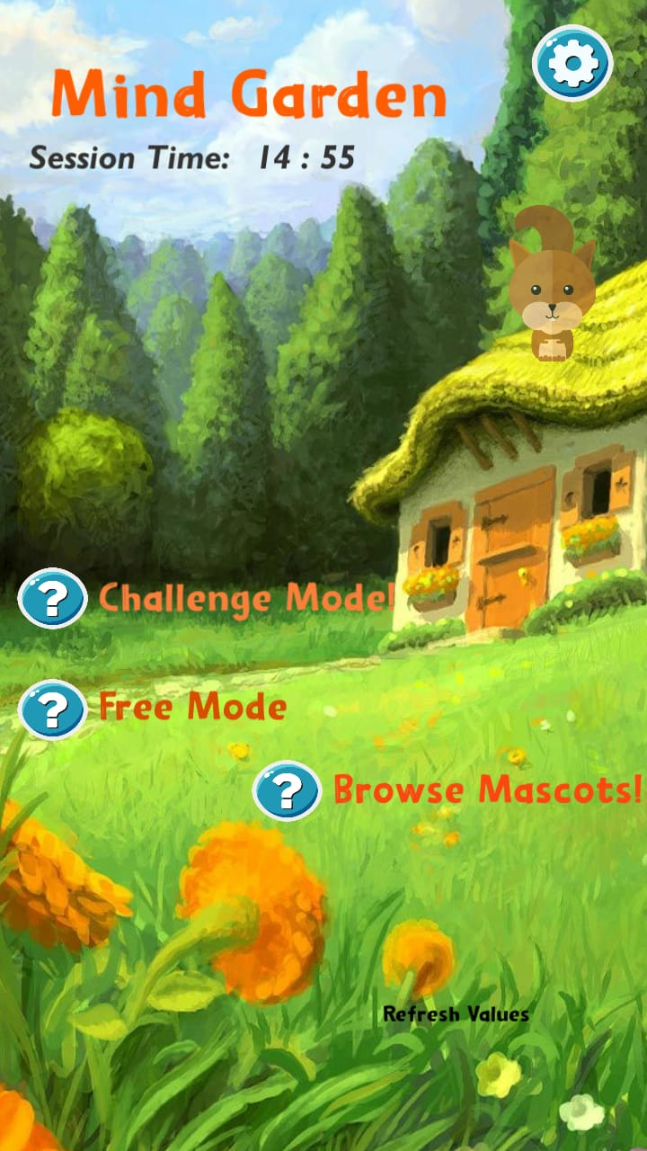
MInd Garden
Game platform which contains series of serious games.
Mascot and tutorial system.
Session timer and access restriction.
Android compatible.
2 Different game modes.

Slide 15
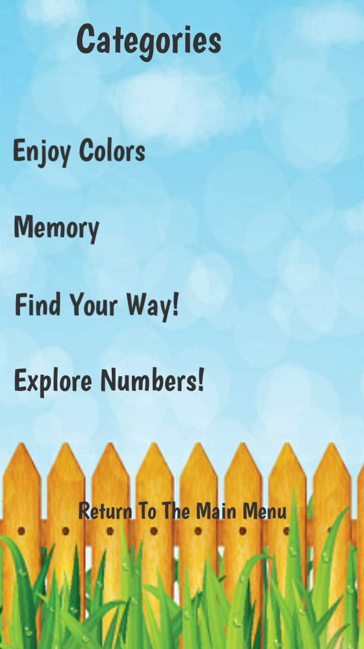
Mınd garden
Challange Mode:
4 random games in a row.
Your performance will rewarded.
You can play only one time for a day.
Free Mode:
Choose any game you want to play from 4 categories.

Slide 16
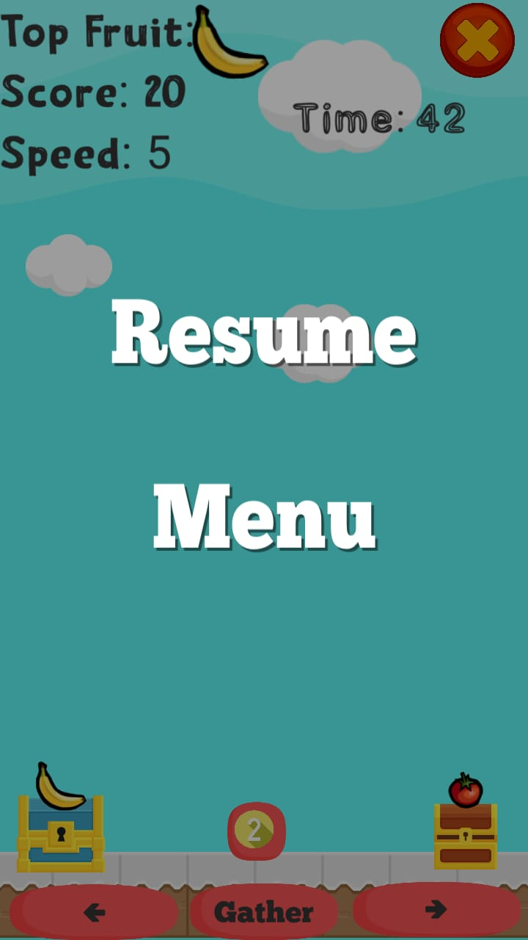
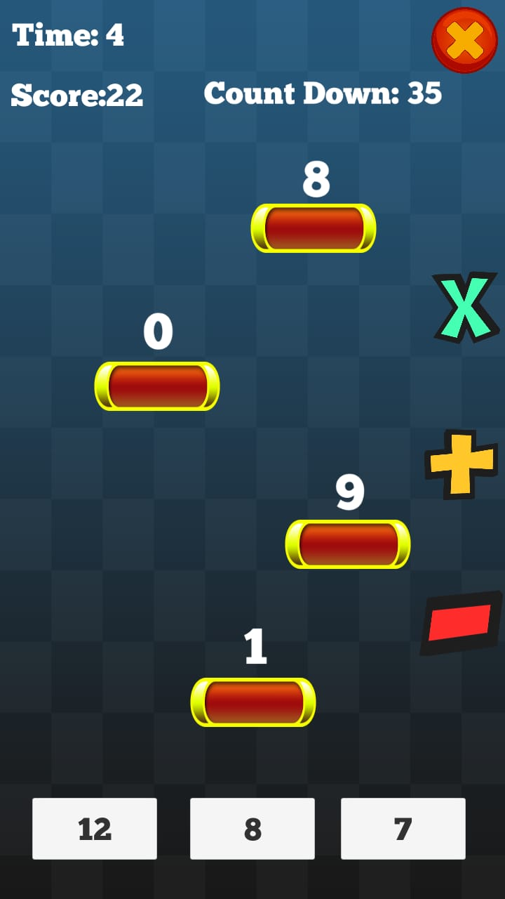
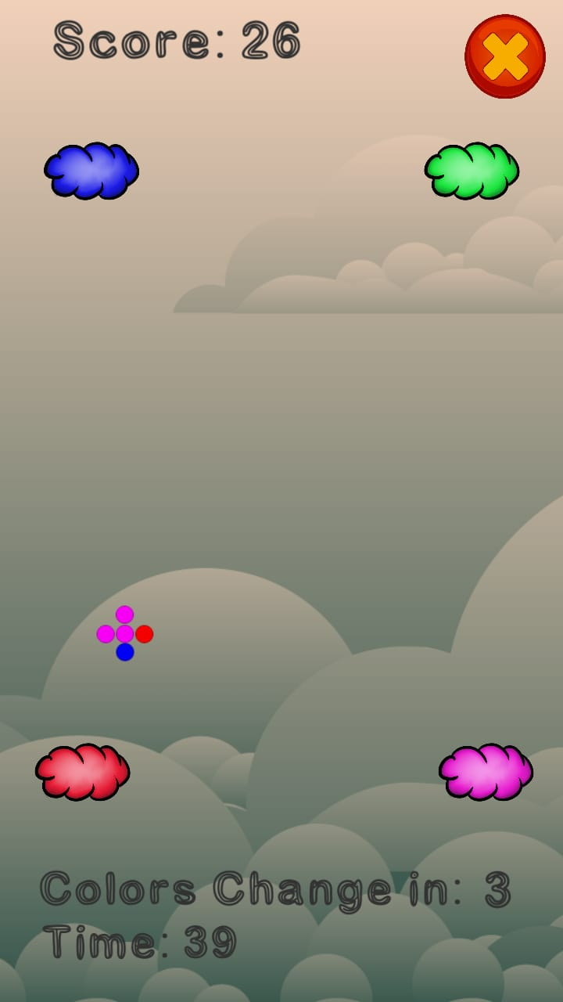
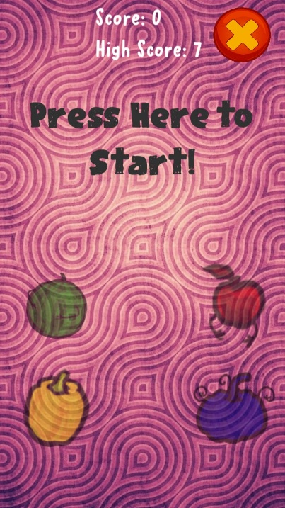
Game scenes

Slide 17
Acknowledgement
We are grateful to:
Murat SARAN, Assist. Prof. Dr.
Arman Demirci, Psychologist M.S.
We appriciate the guidance and attention.

Slide 18
Thank you.
QuestIons ?

